Slide 1
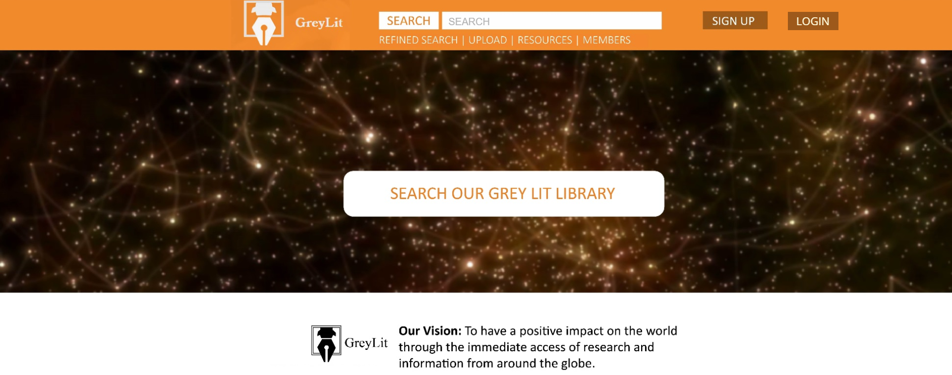
Login page
Notes:
Login Screen- which is done already

Slide 2
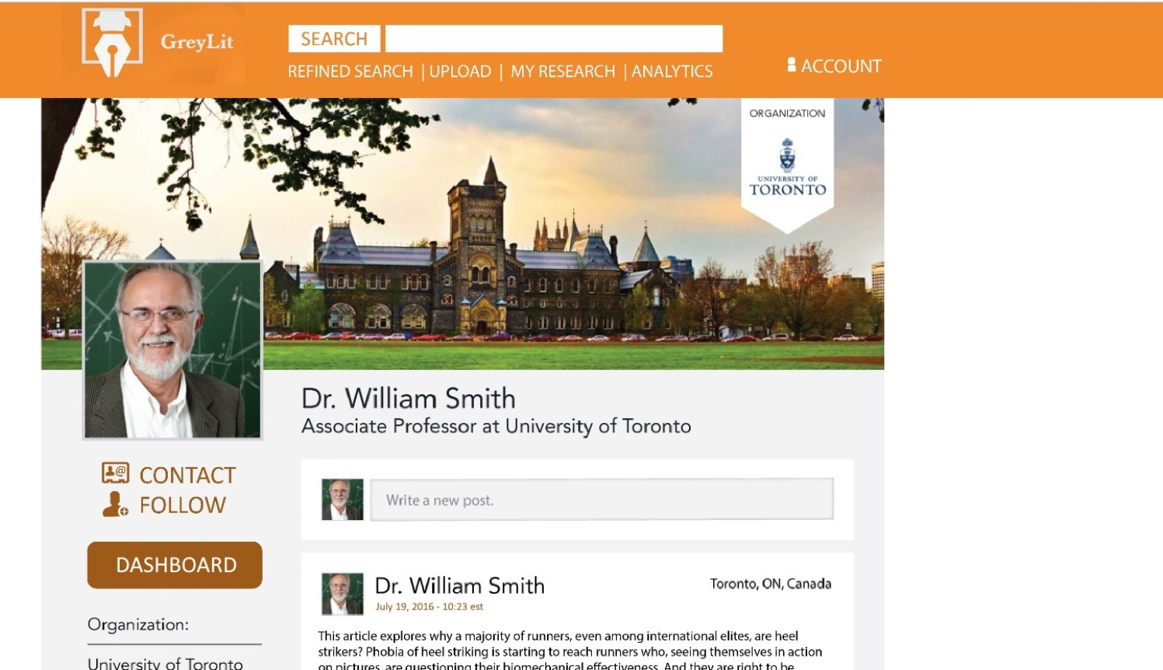
Completed profile page 1 of 3 screens
Would be great to use a real person on the profile page- maybe we could use Evan ?

Slide 3
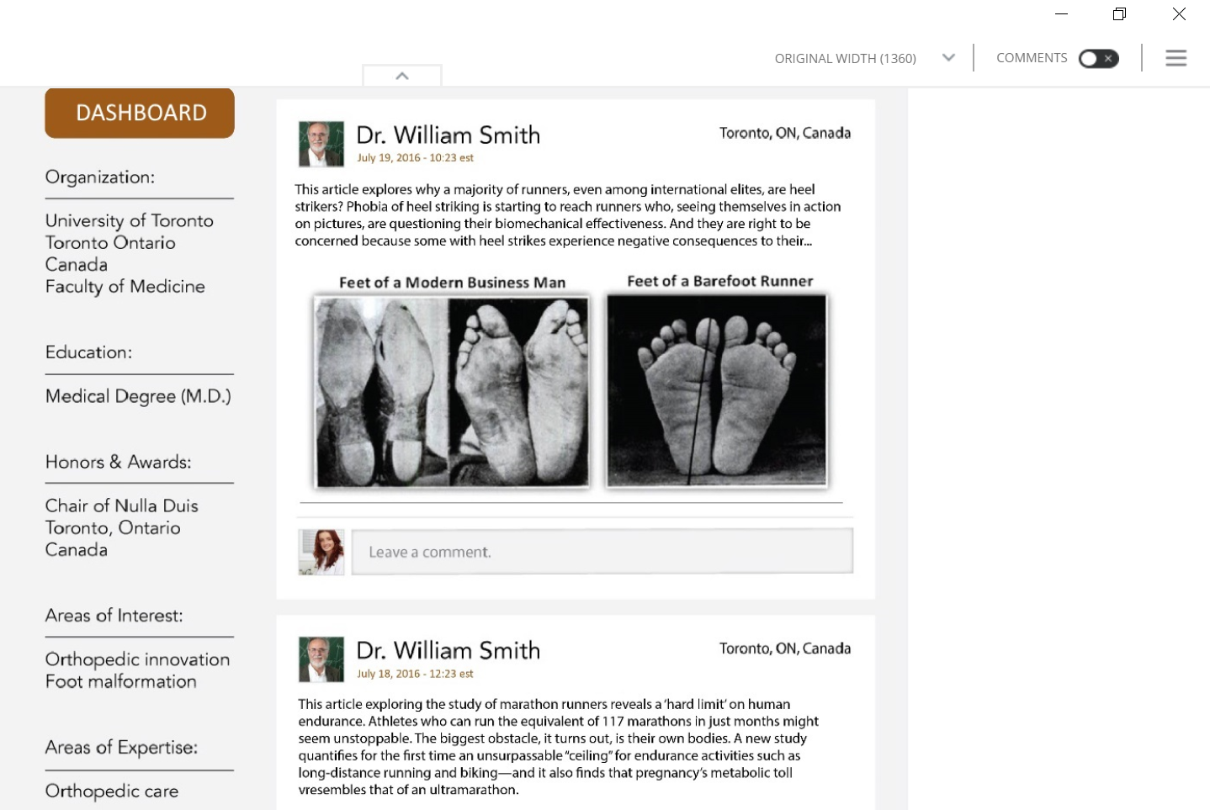
Completed profile page 2 of 3 screens

Slide 4
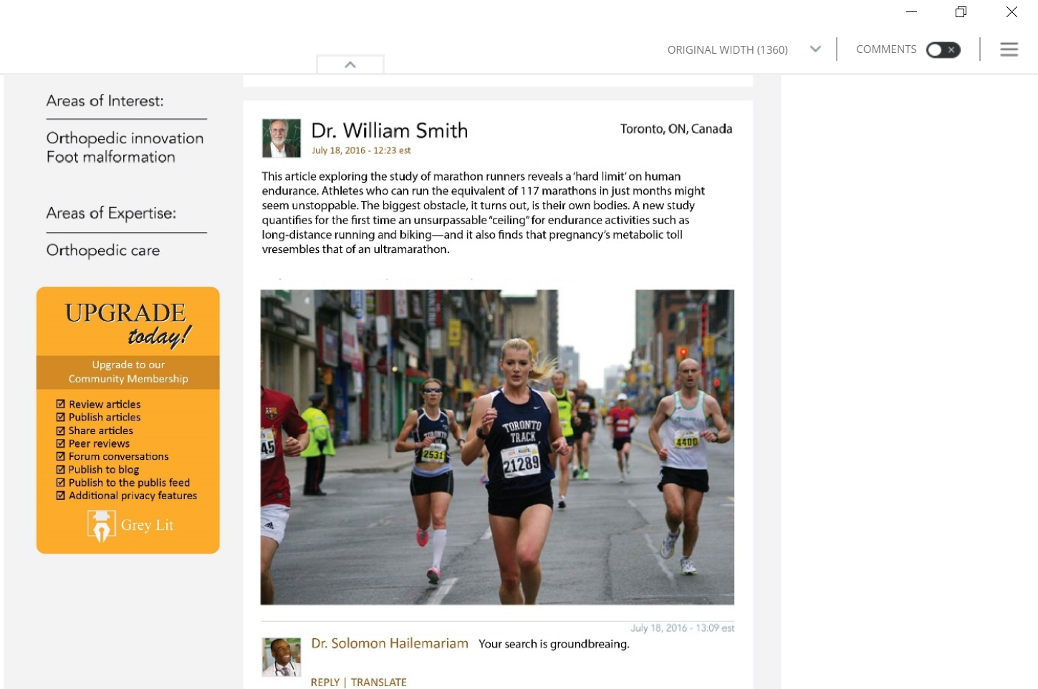
Completed profile page 3 of 3 screens

Slide 5
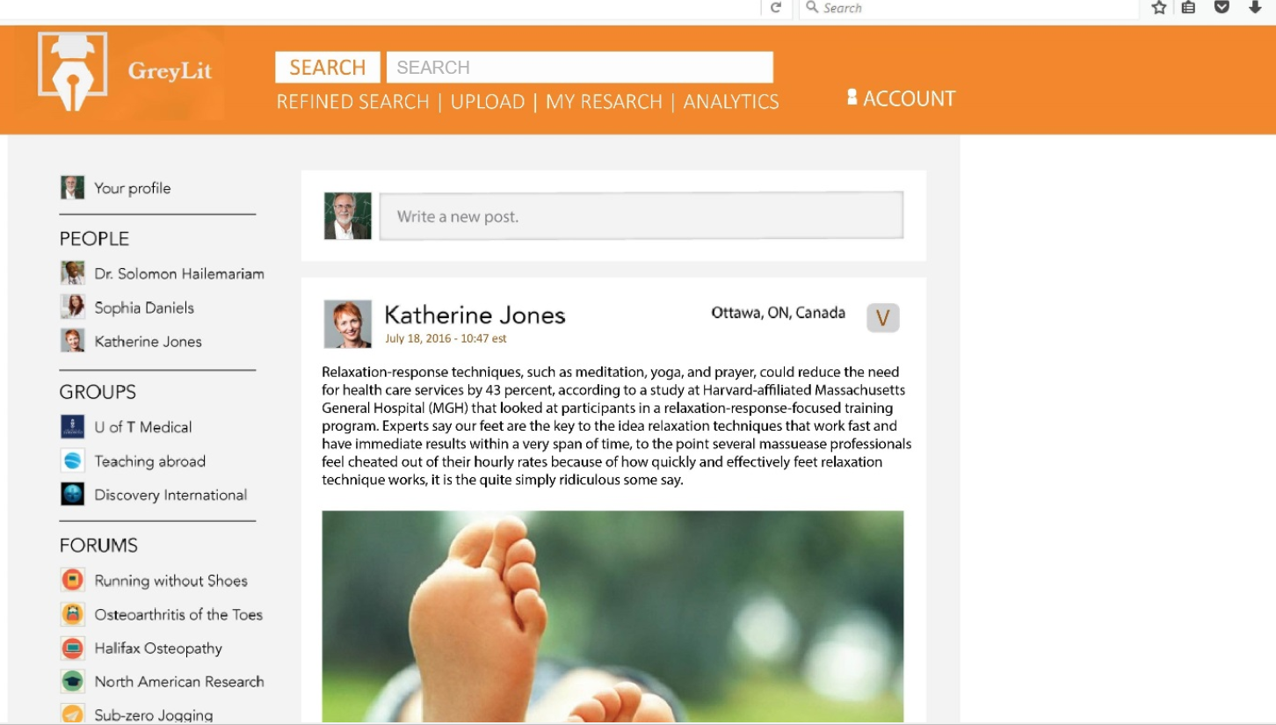
Dashboard page
1 of 2 screen shots
It would be great if the news feed on the Dashboard had real articles or documents, perhaps from the listserv, Dr Vaillancourt or Dr Finely, or any of the RCP stuff. I have lots of content.

Slide 6
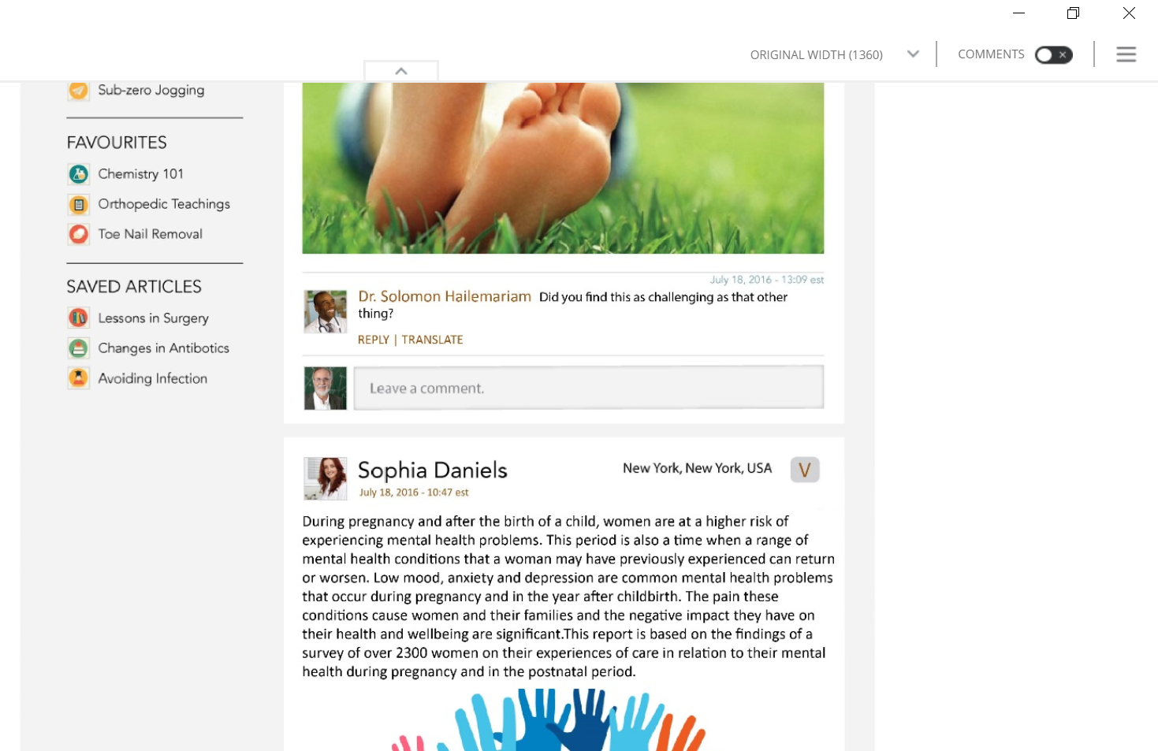
Dashboard page
2 of 2 screen shots

Slide 7
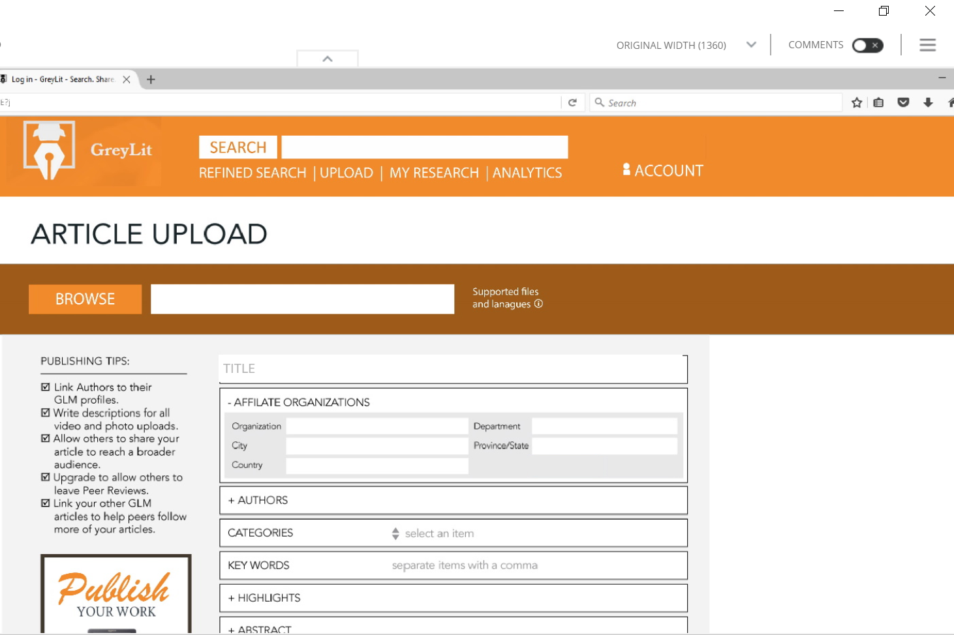
Article upload page. I am still a bit confused about how the Upload function for the demo (sorry). It needs to look easy.

Slide 8
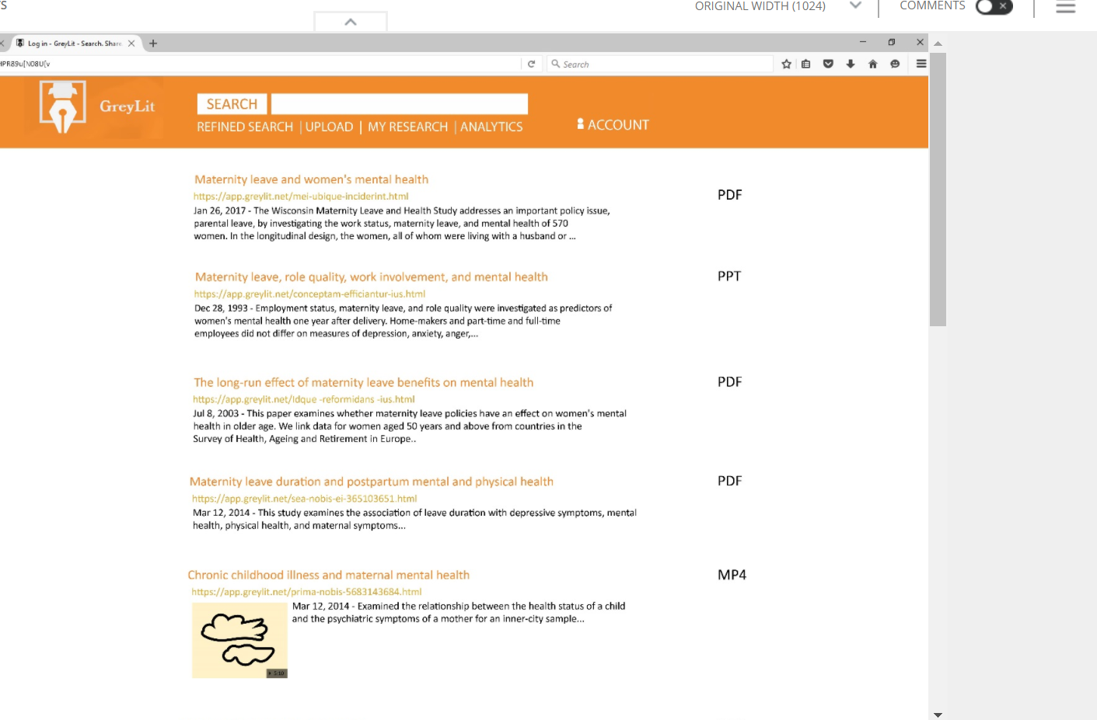
Search function should be at the top of every page Could we search from a few dozen preloaded documents in various formats (ppt, pdf, word, image)?

Slide 9
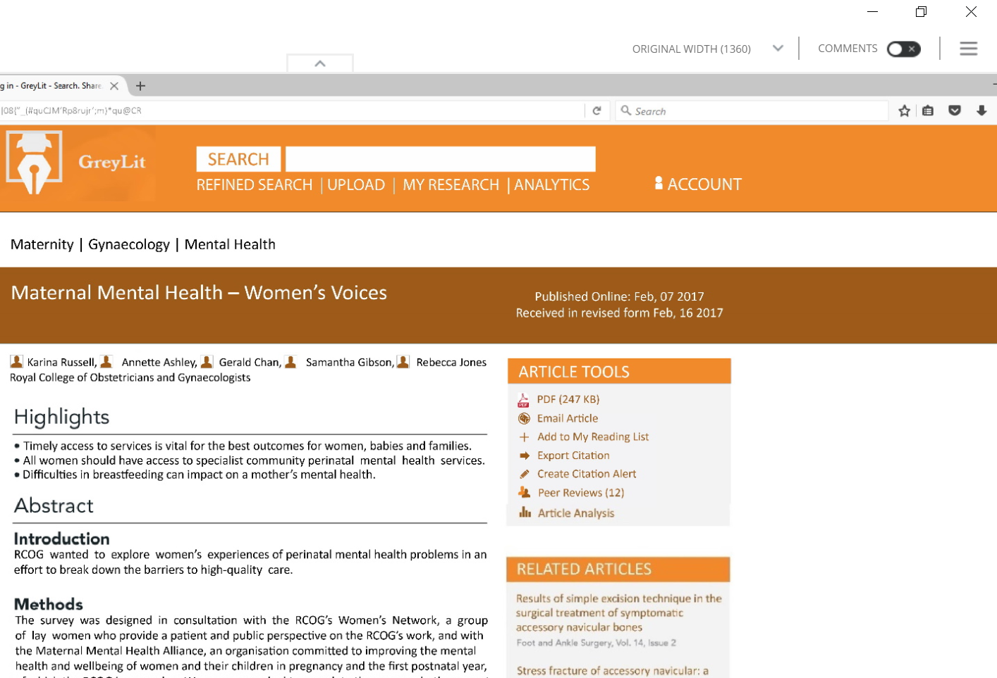
Search Results should show Article tool box, Related Article box. It would be great to have a variety of articles and formats to come back on the return

Slide 10
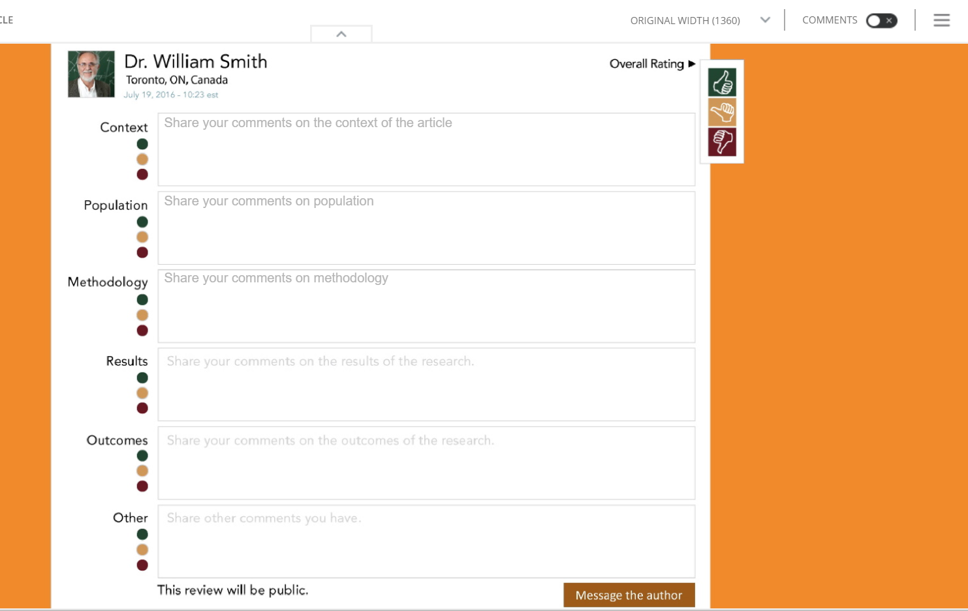
Review page 1 of 1. Needs to have both the quick thumbs up option and the longer option to leave text. Also needs the line about review will be public and to message author

Slide 11
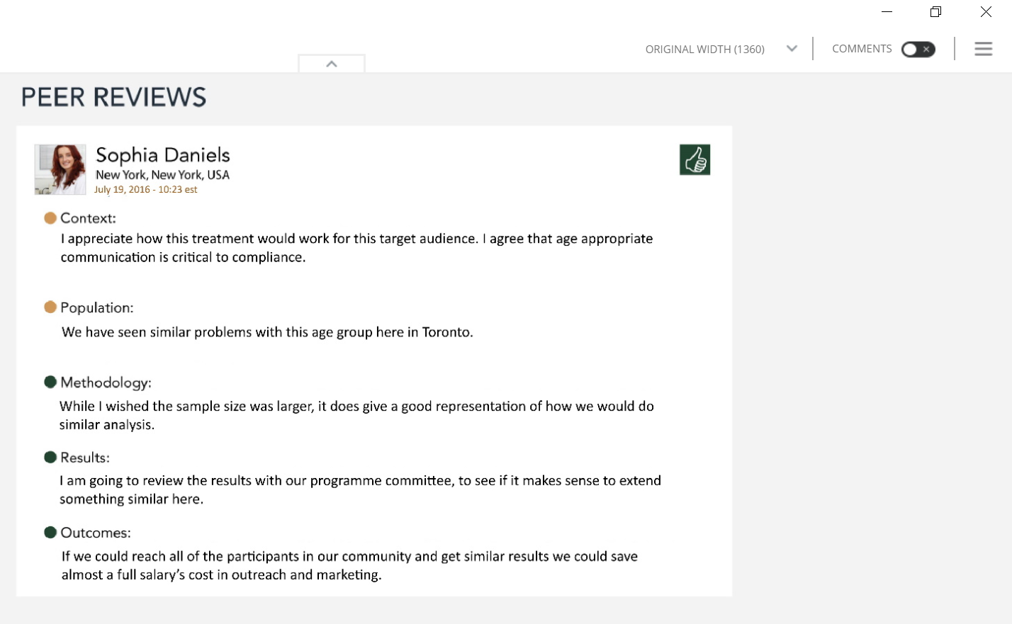
Review page 2 of 2- Shows a couple of mock completed peer reviews for actual articles- perhaps ones that we showed in the search results?

Slide 12
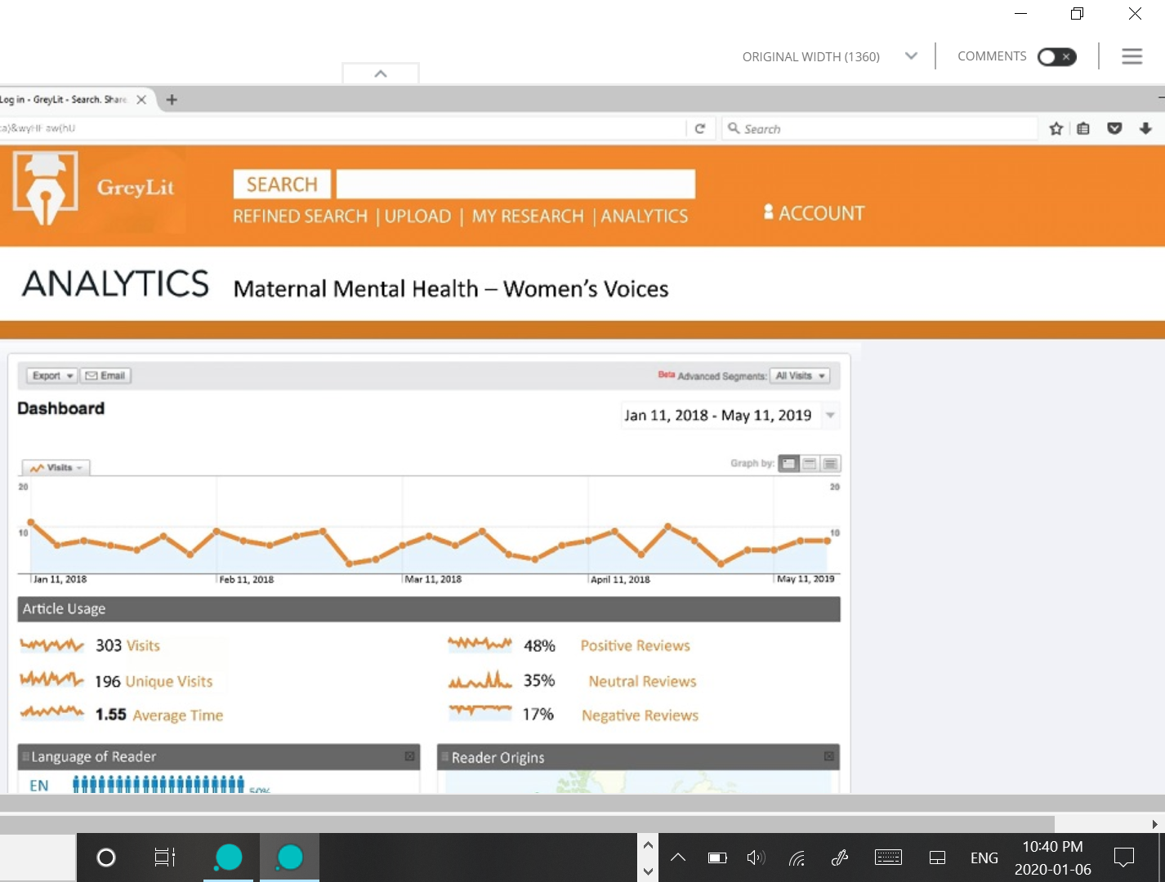
Analytics Screen shot 1 of 2 Again the article that we show the analytics on, should ideally be one that comes back from the search results. Can we make the dates current- maybe a “today’s date” field?

Slide 13
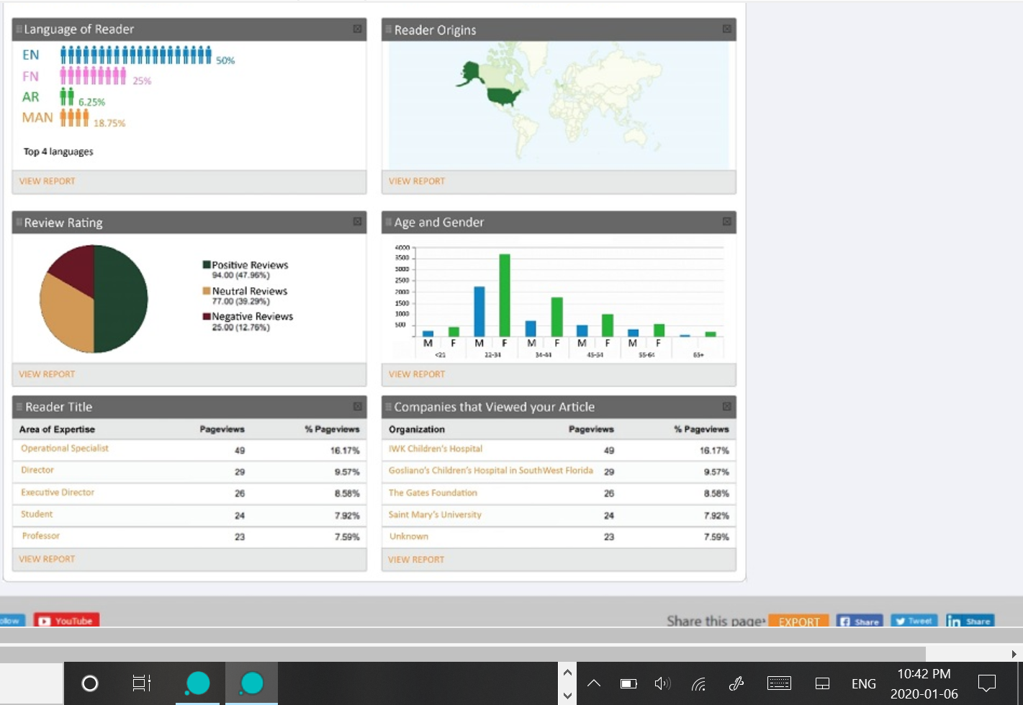
Analytics Screen shot 2 of 2

Slide 14
Pages we need in demo site
Login in Screen
Completed Profile page
Dashboard
Upload
Search
Get to see search results
Review
Blank review
Completed review
Analytics

